Slide 1
Advance Encryption Standard

Slide 2
Topics
Basic AES
Inside Algorithm

Slide 3
Origins
A replacement for DES was needed
Key size is too small
Can use Triple-DES – but slow, small block
Notes:
The Advanced Encryption Standard (AES) was published by NIST (National Institute of Standards and Technology) in 2001. AES is a symmetric block cipher that is intended to replace DES as the approved standard for a wide range of applications. The AES cipher (& other candidates) form the latest generation of block ciphers, and now we see a significant increase in the block size - from the old standard of 64-bits up to 128-bits; and keys from 128 to 256-bits. In part this has been driven by the public demonstrations of exhaustive key searches of DES. Whilst triple-DES is regarded as secure and well understood, it is slow, especially in s/w. In a first round of evaluation, 15 proposed algorithms were accepted. A second round narrowed the field to 5 algorithms. NIST completed its evaluation process and published a final standard (FIPS PUB 197) in November of 2001. NIST selected Rijndael as the proposed AES algorithm. The two researchers who developed and submitted Rijndael for the AES are both cryptographers from Belgium: Dr. Joan Daemen and Dr.Vincent Rijmen.

Slide 4


The AES Cipher - Rijndael
Rijndael was selected as the AES in Oct-2000
Designed by Vincent Rijmen and Joan Daemen in Belgium
Issued as FIPS PUB 197 standard in Nov-2001
An iterative rather than Feistel cipher
processes data as block of 4 columns of 4 bytes (128 bits)
operates on entire data block in every round
Rijndael design:
simplicity
has 128/192/256 bit keys, 128 bits data
resistant against known attacks
speed and code compactness on many CPUs
V. Rijmen
J. Daemen
Notes:
The Rijndael proposal for AES defined a cipher in which the block length and the key length can be independently specified to be 128,192,or 256 bits. The AES specification uses the same three key size alternatives but limits the block length to 128 bits. Rijndael is an academic submission, based on the earlier Square cipher, from Belgium academics Dr Joan Daemen and Dr Vincent Rijmen. It is an iterative cipher (operates on entire data block in every round) rather than feistel (operate on halves at a time), and was designed to have characteristics of: Resistance against all known attacks, Speed and code compactness on a wide range of platforms, & Design simplicity.

Slide 5
Topics
Basic AES
Inside Algorithm

Slide 6
AES
Private key symmetric block cipher
Stronger & faster than Triple-DES
AES encrypts messages in blocks of 128 bits.
AES allows three different key lengths 128, 192 and 256 bits.
The number of rounds in Encryption and Decryption is dependent on the key length.
128 bit – 10 rounds
192 bit – 12 rounds
256 bit – 14 rounds
Notes:
Listed above are NIST’s requirements for the AES candidate submissions. These criteria span the range of concerns for the practical application of modern symmetric block ciphers.

Slide 7
AES Conceptual Scheme
Plaintext (128 bits)
AES
Key (128-256 bits)
Ciphertext (128 bits)

Slide 8
M
(128 Bits)
M1
(128 Bits)
M2
(128 Bits)
KEY – 128 Bits
Sub Key 0
Round 1
Sub Key 1
Round 2
Sub Key 2
Round 3
Sub Key 3
Round 10
Sub Key 10
AES ENCRYPTION
CIPHER TEXT
Notes:
The input to the AES encryption and decryption algorithms is a single 128-bit block, depicted in FIPS PUB 197, as a square matrix of bytes .This block is copied into the State array, which is modified at each stage of encryption or decryption. After the final stage, State is copied to an output.
The key is expanded into 44/52/60 lots of 32-bit words (see later), with 4 used in each round.
The data computation then consists of an “add round key” step, then 9/11/13 rounds with all 4 steps, and a final 10th/12th/14th step of byte subs + mix cols + add round key. This can be viewed as alternating XOR key & scramble data bytes operations. All of the steps are easily reversed, and can be efficiently implemented using XOR’s & table lookups.

Slide 9
High Level Description
Key Expansion
Round keys are derived from the cipher key using Rijndael's key schedule
Initial Round
AddRoundKey : Each byte of the state is combined with the round key using bitwise xor
Rounds
SubBytes : non-linear substitution step
ShiftRows : transposition step
MixColumns : mixing operation of each column.
AddRoundKey
Final Round
SubBytes
ShiftRows
AddRoundKey
No MixColumns
Notes:
The input to the AES encryption and decryption algorithms is a single 128-bit block, depicted in FIPS PUB 197, as a square matrix of bytes .This block is copied into the State array, which is modified at each stage of encryption or decryption. After the final stage, State is copied to an output.
The key is expanded into 44/52/60 lots of 32-bit words (see later), with 4 used in each round.
The data computation then consists of an “add round key” step, then 9/11/13 rounds with all 4 steps, and a final 10th/12th/14th step of byte subs + mix cols + add round key. This can be viewed as alternating XOR key & scramble data bytes operations. All of the steps are easily reversed, and can be efficiently implemented using XOR’s & table lookups.

Slide 10
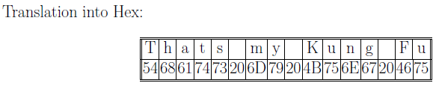
Key Expansion in AES
Key (128 bits) –
01010100
01101000
01100001
01110100
01110011
00100000
01101101
01111001
00100000
01001011
01110101
01101110
01100111
00100000
01000110
01110101

Slide 11
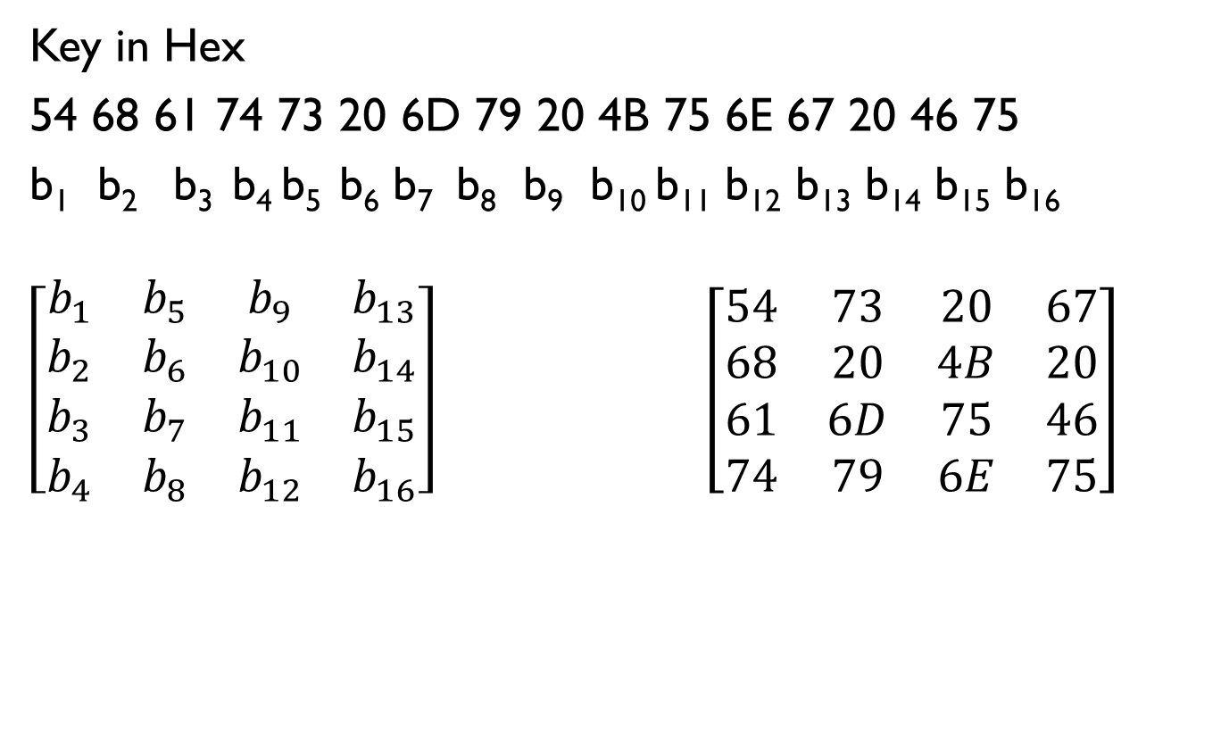
Key Expansion in AES

Slide 12
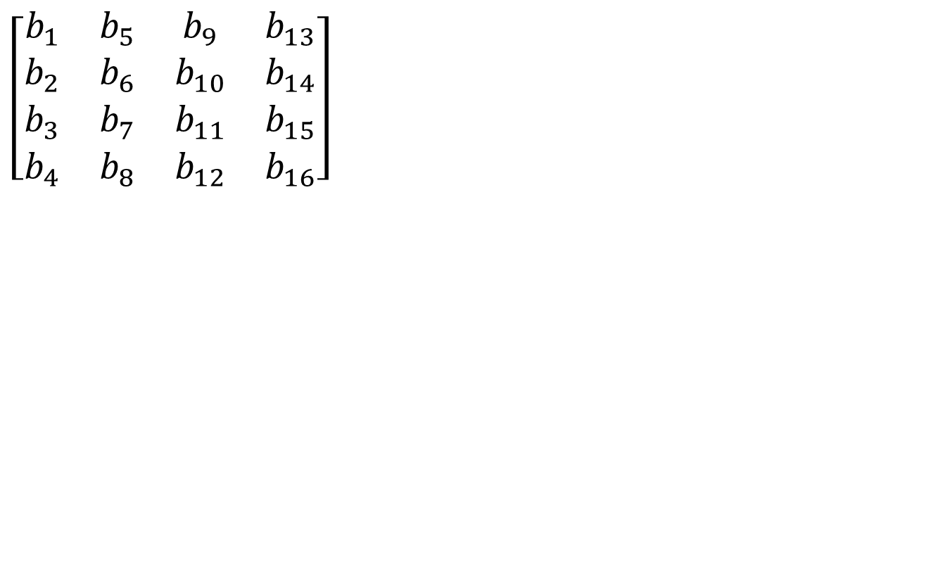
Key Expansion in AES
EXPAND available 4 words in to 40 Words
W0 | W1 | W2 | W3 | W4 | W5 | W6 | W7 | …… | ……. | W43
b₁ b₂ b₃ b₄
b₅ b₆ b₇
b₈
b₉ b₁₀ b₁₁
b₁₂
b₁₃ b₁₄ b₁₅
b₁₆
Notes:
Available 4 words are expanded to 40 words

Slide 13
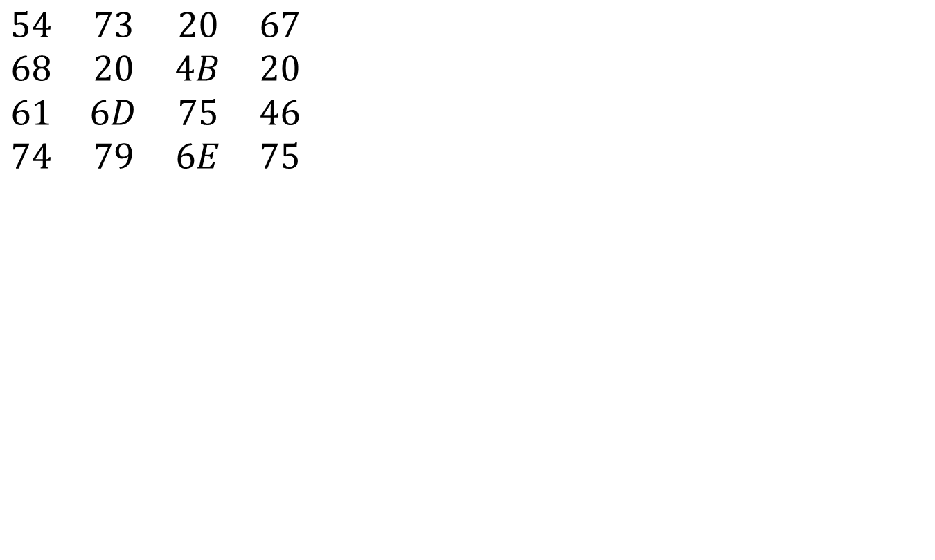
Key Expansion in AES
W0 | W1 | W2 | W3 | W4 | W5 | W6 | W7 | …… | ……. | W43
54
68
61
74
73
20
6D
79
20
4B
75
6E
67
20
46
75
Notes:
Available 4 words are expanded to 40 words
These 4 words are used in Round1 w4 to w7

Slide 14
Key Expansion in AES
W0 | W1 | W2 | W3
g
5468
61
74
73
20
6D
79
20
4B
75
6E
67 20 46
75
What is this Function g?
W4 | W5 | W6 | W7
R15
R16R17
R18
R1
R2
R3
R4
R5
R6
R7
R8
R9
R10R11
R12
W4= W0 g(W3)

Slide 15
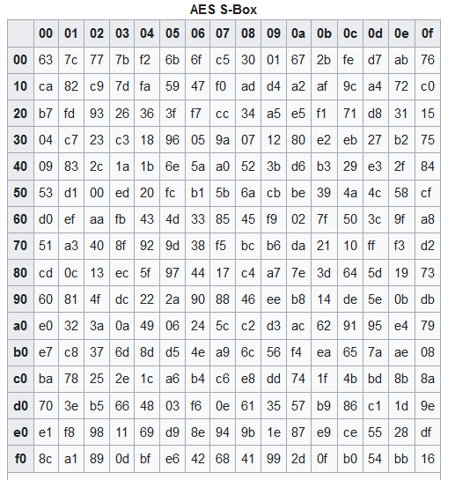
What is this function g?
RotWord performs a one-byte circular left shift on a word.
This means that an input word [B0, B1, B2, B3] is transformed into [B1, B2, B3, B0].
W4= W0 g(W3)
W3
67
20
46
75
RotWord
(X1)
20
46
75
67
SubWord
(Y1)
b7
5a
9d
85
SubWord performs a byte substitution on each byte of its input word, using the S-box
Notes:
Perform cyclic left shift by one byte
W3 one left shift

Slide 16
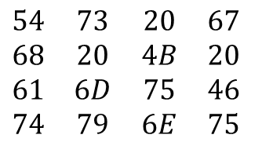
Key Expansion in AES
W3
67
20
46
75
RotWord
(X1)
20
46
75
67
SubWord
(Y1)
b7
5a
9d
85
The result Y1 is XORed with a round constant, Rcon[j].
R1 | R2 | R3 | R4 | R5 | R6 | R7 | R8 | R9 | R10
01 | 02 | 04 | 08 | 10 | 20 | 40 | 80 | 1B | 36
00 | 00 | 00 | 00 | 00 | 00 | 00 | 00 | 00 | 00
00 | 00 | 00 | 00 | 00 | 00 | 00 | 00 | 00 | 00
00 | 00 | 00 | 00 | 00 | 00 | 00 | 00 | 00 | 00
Y1 10110111 01011010 10011101 10000101
R1 00000001 00000000 00000000 00000000
g(w3)10110110 01011010 10011101 10000101
g(w3) - B6 5A 9D 85
Notes:
In round constant first byte exist and remaining 3 bytes are zeros
R! is a word of 32 bits

Slide 17
Key Expansion in AES
W0 - 01010100 01101000 01100001 01110100
G(w3) - 10110110 01011010 10011101 10000101
Result - 11100010 00110010 11111100 11110001
Result (W4) - E2 32 FC F1
W4 - 11100010 00110010 11111100 11110001
W1 - 01110011 00100000 01101101 01111001
Result - 10010001 00010010 10010001 10001000
Result (W5) - 91 12 91 88
W0 | W1 | W2 | W3
g
₂₀
4B
75
6E
5468
61
74
73
20
6D
79
6720 46
75
What is this Function g?
W4 | W5 | W6 | W7
R15
R16R17
R18
R1
R2
R3
R4
91
12
91
88
E2
32
FC
F1
R5
R6
R7
R8
R9
R10R11
R12
B1
59
E4
E6
D6
79
A2
93
W4= W0 g(W3)
W0 | W1 | W2 | W3 | W4 | W5 | W6 | W7 | …… | ……. | W43

Slide 18

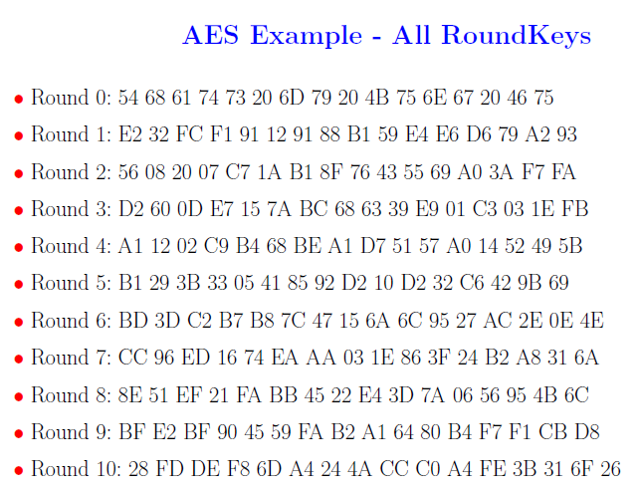
Key Expansion in AES

Slide 19
M
(128 Bits)
M1
(128 Bits)
M2
(128 Bits)
KEY – 128 Bits
Sub Key 0
Round 1
Sub Key 1
Round 2
Sub Key 2
Round 3
Sub Key 3
Round 10
Sub Key 10
AES ENCRYPTION
CIPHER TEXT
Notes:
The input to the AES encryption and decryption algorithms is a single 128-bit block, depicted in FIPS PUB 197, as a square matrix of bytes .This block is copied into the State array, which is modified at each stage of encryption or decryption. After the final stage, State is copied to an output.
The key is expanded into 44/52/60 lots of 32-bit words (see later), with 4 used in each round.
The data computation then consists of an “add round key” step, then 9/11/13 rounds with all 4 steps, and a final 10th/12th/14th step of byte subs + mix cols + add round key. This can be viewed as alternating XOR key & scramble data bytes operations. All of the steps are easily reversed, and can be efficiently implemented using XOR’s & table lookups.

Slide 20
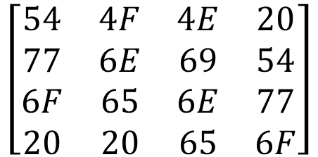
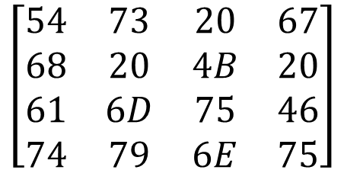
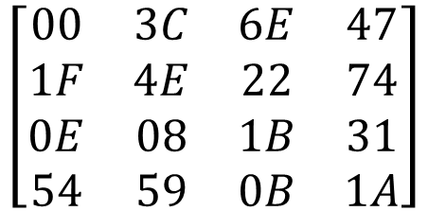
Plain text
Two One Nine Two
M
(128 Bits)
[54 77 6F 20 4F 6E 65 20 4E 69 6E 65 20 54 77 6F ]
69 01101001
4B 01001011
Result 00100010
49 4B =22

Slide 21
M
(128 Bits)
M1
(128 Bits)
M2
(128 Bits)
KEY – 128 Bits
ADD ROUND
KEY
Sub Key W0 W1 W2 W3
Round 1
Sub Key W4 W5 W6 W7
Round 2
Sub Key W8 W9 W10 W11
Round 3
Sub Key W12 W13 W14 W15
Round 10
Sub Key W40 W41 W42 W43
AES ENCRYPTION
CIPHER TEXT

Slide 22
Need to understand a Round What are the Steps in a Round?

Slide 23
Round
Consists of Four Steps
Substitute Bytes
Shift Rows
Mix Columns
Add Round Key

Slide 24
M
(128 Bits)
M1
(128 Bits)
M2
(128 Bits)
KEY – 128 Bits
ADD ROUND
KEY
Sub Key W0 W1 W2 W3
Round 1
Sub Key W4 W5 W6 W7
Round 2
Byte Substitution
Shift Rows
Mix Columns
Add Round Key
Sub Key W8 W9 W10 W11
Round 10
Sub Key W40 W41 W42 W43
AES ENCRYPTION
CIPHER TEXT

Slide 25
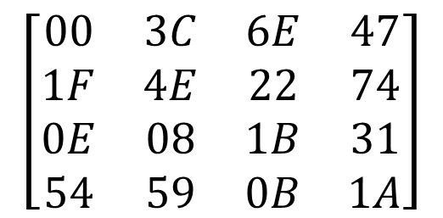
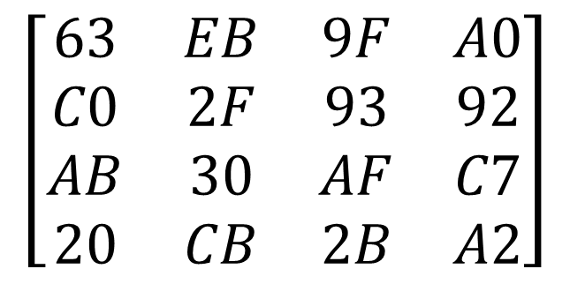
Byte Substitution
substitute each entry (byte) of current state matrix by corresponding entry in AES S-Box
for instance: byte 6E is substituted by entry of S-Box in row 6 and column E, i.e., by 9F
this leads to new State Matrix

Slide 26
Shift Rows
Shift Rows simply byte shifts the rows
First row: no change
Second row: one byte cyclical left shift
Third row: two byte cyclical left shift
Fourth row: three byte cyclical left shift

Slide 27
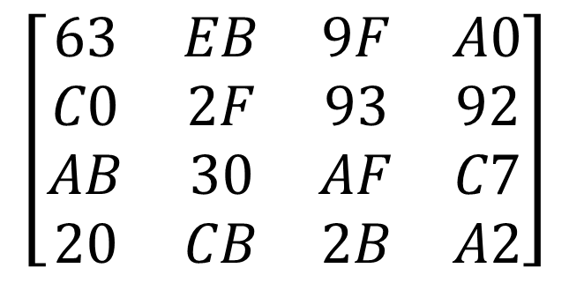
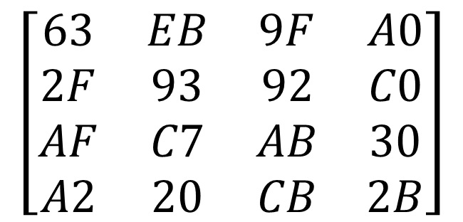
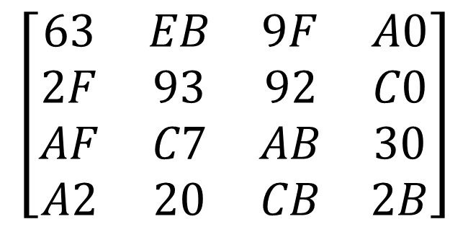
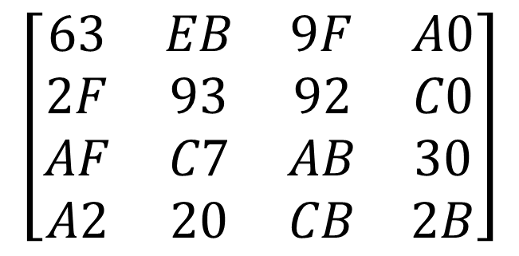
Shift Rows
four rows are shifted cyclically to the left by offsets of 0,1,2, and 3

Slide 28
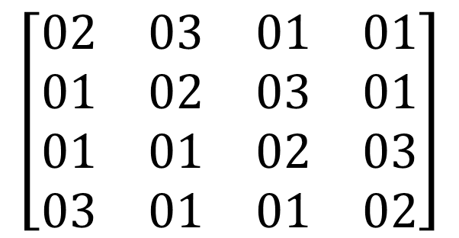
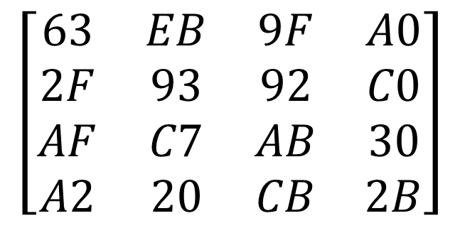
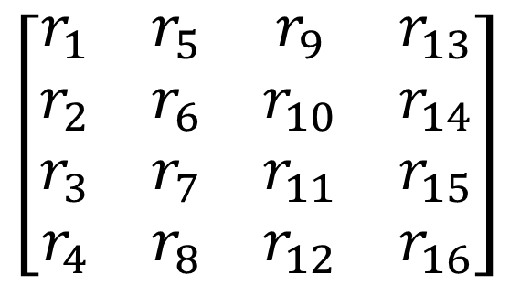
Mix Columns
*
The last round for encryption does not involve the “Mix columns” step.

Slide 29
Lets calculate r1
01=00000001=1
AF=10101111= X⁷+ X⁵+X³+X²+X⁺1
-------------------------------------------------
X⁷+ X⁵+X³+X²+X+1 =10101111
-------------------------------------------------
01=00000001
A2=10100010
-------------------------------------------------
= X⁷+ X⁵+X = 10100010
-------------------------------------------------
02*63 + 03 * 2F + 01*AF + 01 * A2
02= 00000010➔ X
63= 01100011-> X⁶+X⁵+X+1
--------------------------------------------------------
X(X⁶+X⁵+X+1)=X⁷+X⁶+X²+X
110000110
--------------------------------------------------------
03=00000011->X+1
2F=00101111->X⁵+X³+X²+X+1
-----------------------------------------------------------
(X+1)*(X⁵+X³+X²+X+1)=X⁶+X⁴+X³+X²+X+ X⁵+X³+X²+X+1
= X⁶+ X⁵+X⁴+1 = 01110001
------------------------------------------------------------
11000110
01110001
10101111
10100010
-----------------
10111010=BA
-----------------
or
X⁷+X⁶+X²+X+X⁶+X⁵+X⁴+1+ X⁷+ X⁵+ X³+X²+X+1+X⁷ + X⁵+X ( cancel common terms)
=X⁷+X⁵+X⁴+X³+X=10111010=BA
Notes:
X8=X8+X4+X3+X+1

Slide 30
Exercise – compute r6
01*EB + 02*93 + 03*C7 + 01 * 20
01= 00000001➔ 1
EB= 11101011> X⁷+X⁶+X⁵+X³+X+1
---------------------------------------------
11101011
---------------------------------------------
02=00000010->X
93= 10010011 ->X⁷+X⁴+X+1
---------------------------------------------
(X)*(X⁷+X⁴+X+1)=P(x)=X⁸+X⁵+X²+X
=100100110
P(m)= X⁸+X⁴+X³+X+1=100011011
P(x)=X⁸+X⁵+X²+X
On dividing P(x)/P(m)= 00111101
-----------------------------------------------
03=00000011=X+1
C7=11000111= X⁷+ X⁶+X²+X+1
= X⁸+ X⁷+X³+X²+X+ X⁷+ X⁶+X²+X+1
= P(x)=X⁸+ X⁶+ X³+1 =101001001
P(m)= X⁸+X⁴+X³+X+1=100011011
On dividing P(x)/P(m)=X⁸+X⁴+X³+X+1=01010010
---------------------------------------------------
01*20=00100000=X⁵
---------------------------------------------------
11101011
00111101
01010010
00100000
-----------------
10100100 =A4
----------------
or
X⁷+X⁶+X⁵+X³+X+1+X⁸+X⁵+X²+X+ X⁸+ X⁶+ X³+1 +X⁵ (on cancelling common terms)
=X⁷+X⁵+X²=10100100=A4
Notes:
X8=X8+X4+X3+X+1

Slide 31
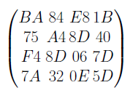
Mix Columns
*
The last round for encryption does not involve the “Mix columns” step.

Slide 32
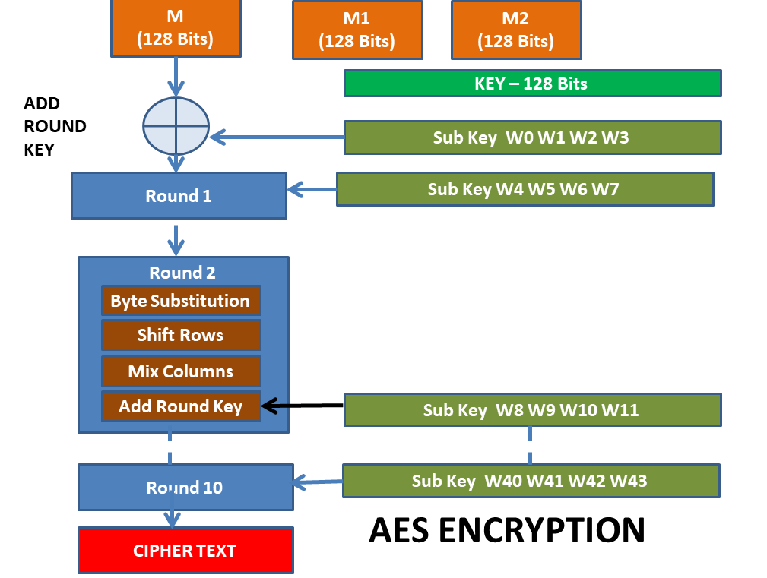
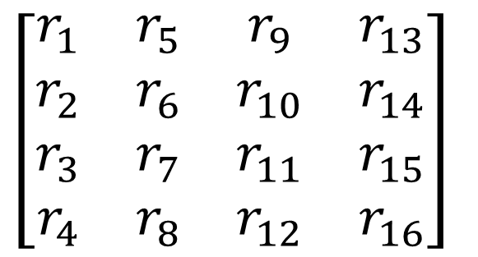
Add Round Key
XOR the state array with 128 bits of round key
For round 1 it is w4,w5,w6,w7 (sub key) is used
The last round for encryption does not involve the “Mix columns” step.
Sub Key W4 W5 W6 W7
Round 2

Slide 33
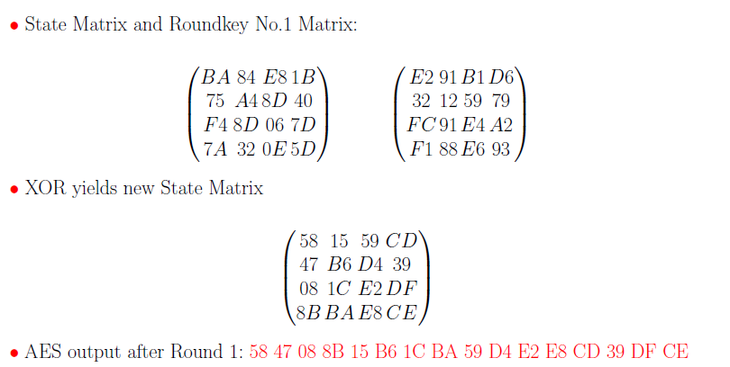
AES Example - Add Roundkey, Round 1

Slide 34
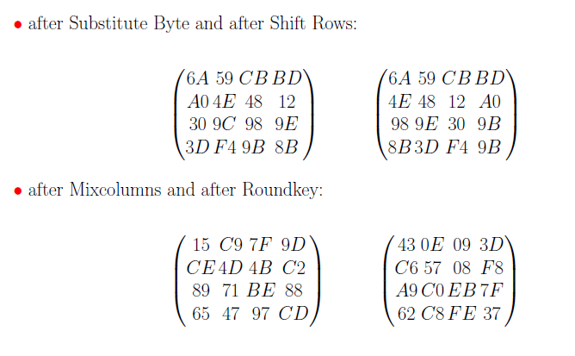
AES Example - Round 2

Slide 35
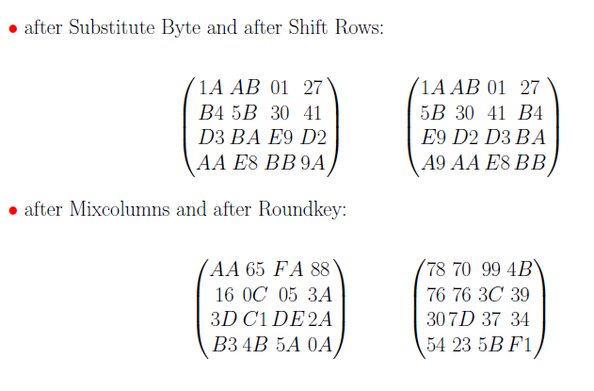
AES Example - Round 3

Slide 36
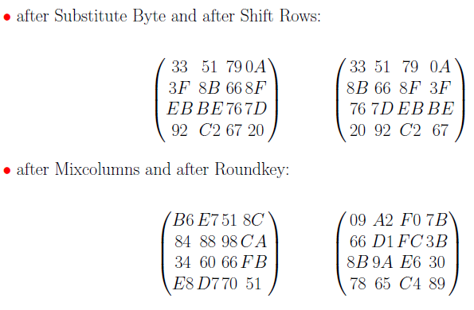
AES Example - Round 9

Slide 37
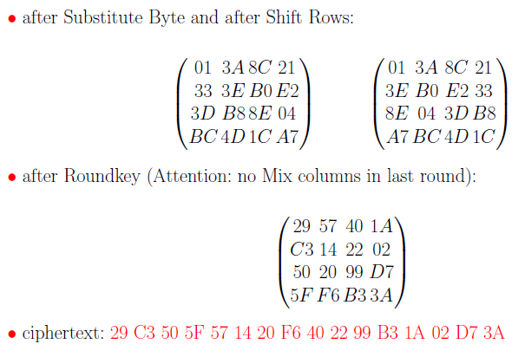
AES Example - Round 10

Slide 38
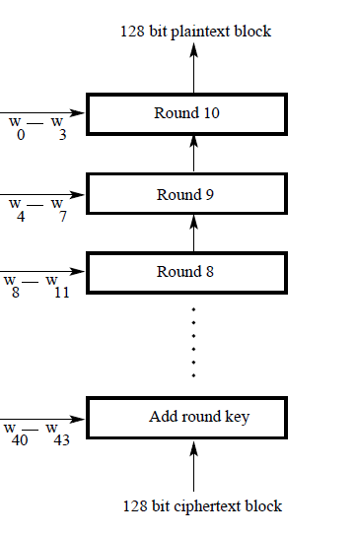
Decryption

Slide 39
Decryption - Round
Round has the following steps
Substitution Bytes
Shift Rows
Mixing Columns (Not applicable for Round 10)
Add round key

Slide 40
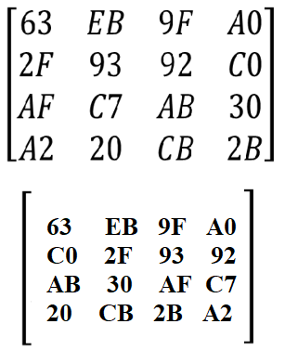
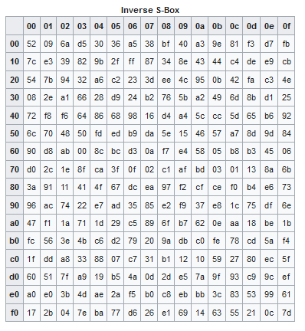
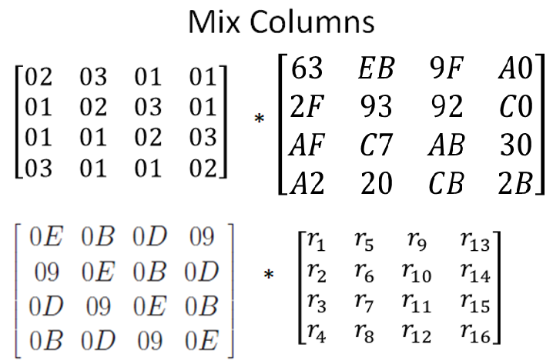
Decryption
Substitution Bytes - An inverse S box is used for byte substitution
Shift Rows – Rows are shifted right in decryption
1st row – unchanged ,
2nd row shifted right by 1
3rd row shifted right by 2
4th row shifted right by 3
Mix Columns
Add Round Key

